Slide 1

Year 2
Information for Parents and Carers

Slide 2
Staff working in Year 2
Teacher - Mrs Thornhill
PPA Cover (WED – Alternating Terms AM/PM)
Mrs King - History
Mr Troth - PE
Teaching Assistants –
Mrs Brown
Mrs Turmer
Mrs Mitchell

Slide 3

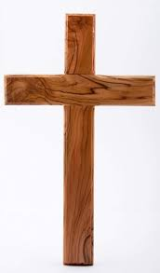

Worship
Worship will take place every day at 8:50am in the school hall. This will be led by different staff members, as well as representatives from St. Guthlac’s Church.
Merit worships take place on Friday mornings to celebrate individual children’s work and birthdays.

Slide 4
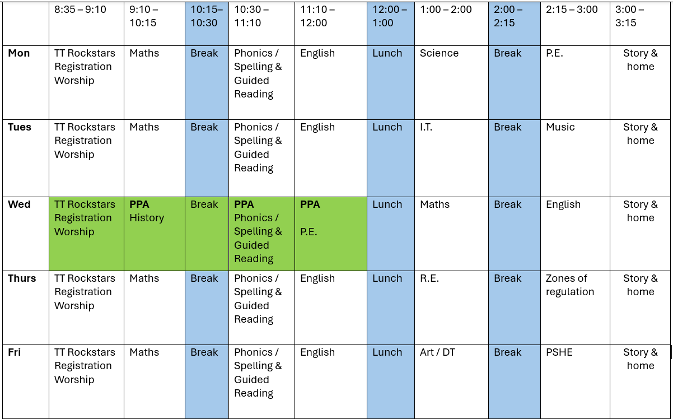
Year 2 Timetable:

Slide 5
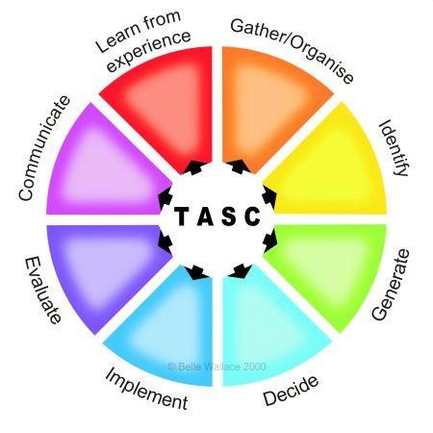
The children will be working on the Year 2 standards in the National Curriculum.
How do we judge how well your children are progressing?
Sharing learning objectives and success criteria together.
Questioning
Partners/Small group work
Self evaluation
TASC / Using and Applying
Guided groups
Recorded work
Summative assessment
Thinking actively in a social context
Notes:
thinking actively in a social context

Slide 6
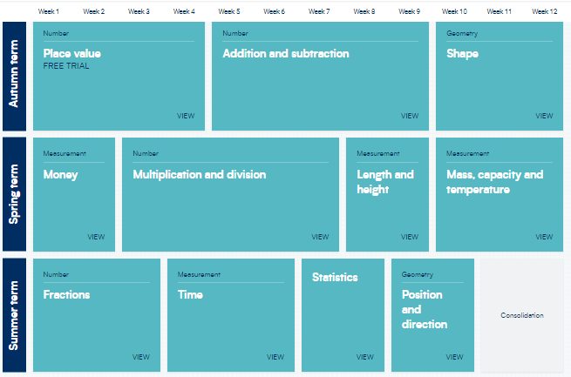
Maths:
These are the areas that the children will work on during Year 2 (please note that the order of teaching may vary).

Slide 7

Maths
For information on how we are teaching maths in school, please follow the link below.
School website –> Our Learning -> Maths support

Slide 8
English: Grammarsaurus
Term 1:
Grammarsaurus PVPG unit
Focus on punctuation and grammar and the correct sentence formation.
Information report
We will link our writing in English to our learning in science where we will be writing a non-chronological report on seasons.
Skills covered –
Capital letters for proper nouns
Using co-ordinating conjunctions
Writing for the purpose of informing
Using headings

Slide 9
Reading expectations for Year 2
Be able to read and understand a wide range of fiction (stories, poems, plays) and non-fiction (information) texts.
Read and perform poems and plays.
Check that the text makes sense as they are reading; stopping and self-correcting mistakes.
Finding information in a text.
Asking and answering questions to show an understanding of the text.
Inferring characters' feelings and thoughts from their actions.
Predicting what might happen next.
Making links between the text and other things they have read.

Slide 10
Writing expectations for Year 2
Children will build on previous learning
Use different types of sentences (statements, questions, exclamations and commands) to engage the reader, using the correct punctuation.
Use conjunctions to give the reader more information (and, or, so, but, because, when, if, that).
Use a range of word types to entertain and inform the reader (nouns, adjectives, noun phrases, present tense verbs, past tense verbs, adverbs.)
Use a varied range of punctuation:
  capital letters, full stops, question marks, exclamation marks, commas for lists.
  apostrophes for possession (the girl’s dress…)
  apostrophes for contraction (don’t, I’m, can’t, he’d, etc.)
Form upper and lower case letters with the correct size, relative to one another.
Use spacing between words that reflects the size of the letters.

Slide 11
Geography and History topics
Term 1 – How was school different in the past?
Term 2 – Would you prefer to live in a hot or cold place?
Term 3 – How did we learn to fly?
Term 4 – Why is our world wonderful?
Term 5 – What is a monarch?
Term 6 – What is it like to live by the coast?

Slide 12
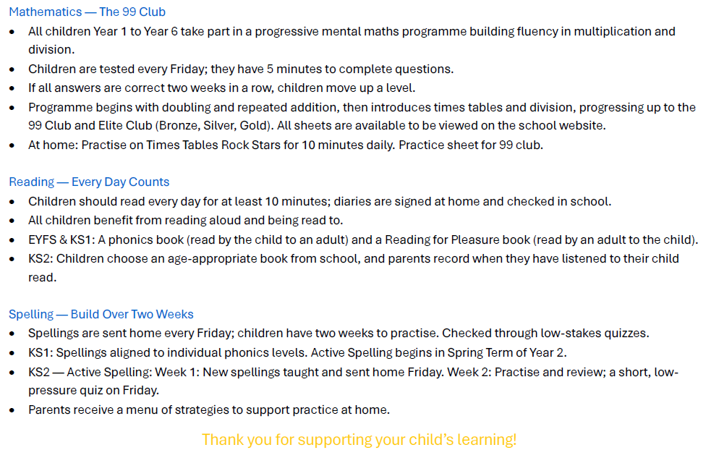
Homework

Slide 13

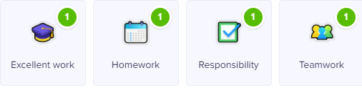

Class Dojo
Children can earn Dojo points for displaying any of the following:
Certificates will be presented if children reach the following milestones:
30 Dojos – Bronze
60 Dojos – Silver
100 Dojos – Gold
150 Dojos - Platinum

Slide 14

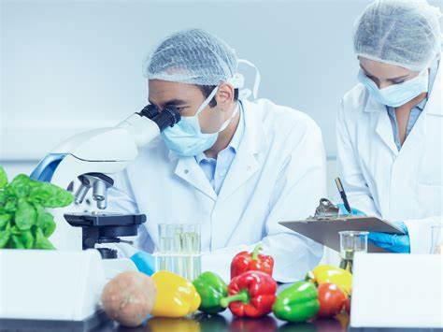
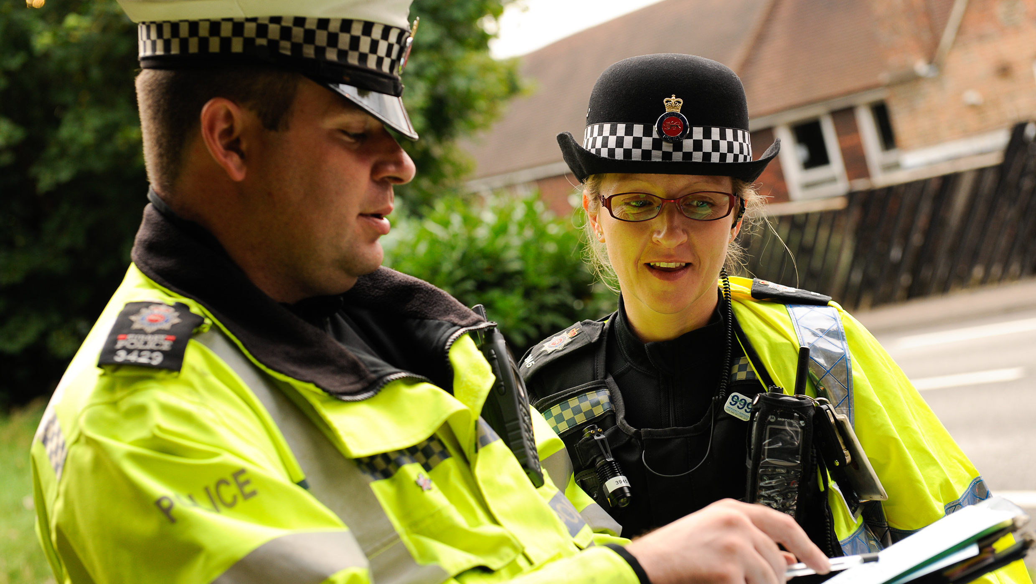
Aspirations
We are very keen to promote and enhance career aspirations for our children. To this end, we are exploring some of the careers that individual subjects could lead to.
Have a look at the booklets that have been produced by subject leaders to introduce the children to some of these careers…

Slide 15
Spelling expectations for Year 2
There will be spelling sessions each morning using the RWI Phonics Scheme for those children still assessed at phonics level.
As the year progresses most children will move off of the RWI scheme to access Active Spellin. This follows the Year 2 national curriculum for spelling which includes new spelling patterns (such as the ‘o’ sound spelt ‘a’ after w and qu in words such as want, quantity, etc), suffixes (-ed, -ing, -ly, etc), common exception words (‘tricky’ words that cannot be sounded out) and homophones (hear / here, see / sea, etc.)
Weekly targeted spelling tests will take place on Thursdays.

Slide 16
Science
Seasonal change – TERM 1
Materials – TERM 2
Plants – TERM 3
Animals, including Humans – TERM 4/5
Living things and their habitats TERM 5 /6
We will weave through practical investigations throughout the school year to ensure scientific curiosity is consistent and progressive. Children are encouraged to ask questions and think critically.

Slide 17
Key Assessment Dates:
Year 2 Phonics Screening retakes
To take place during the week commencing ……..
Please note that from the 2023/24 academic year, the Key Stage One SATs (Year 2) are no longer statutory. However, the SAT papers are still available to schools and may be completed to provide internal data. This is not reported to the government.

Slide 18
Collection arrangements
Please let either your child’s class teacher or the school office know of any changes to collection arrangements.
For safeguarding reasons, we cannot let children go home with adults not on collection lists unless you have given us prior notification.
Please note that dogs (except guide dogs) are not permitted on the premises under any circumstances.

Slide 19
Useful Information
PE is on Monday afternoon with Mrs Thornhill and Wednesday mornings or afternoons with Mr Troth . Please ensure that children come to school in their PE kits on these days.
Please ensure that hair is tied back and earrings removed on PE day.
Information on Forest school will be sent from the office.
Children need to bring their water bottles containing water (not squash) every day.
Please keep big bags to a minimum as we do not have room to store things that do not fit in their lockers.

Slide 20
What can you do to help your child?
Listening to your child read and questioning them about what they have read.
Times tables need to be learned – the expectation for the end of Year 3 is to know the 2, 3, 4, 8 and 10 times tables.
Provide a quiet place and encouragement for homework to be completed.
Use Maths in everyday situations, ask your child to tell you the time, what will it be in …?
Encourage your child to be involved with money when shopping, using the right amount of coins etc.

Slide 21
Remember the school website for additional information.
www.williamhildyard.lincs.sch.uk

Slide 22
We are looking forward to a very positive year ahead. Should you have any questions, please contact the school office via telephone or email and we will arrange a time to contact you.

