Slide 1
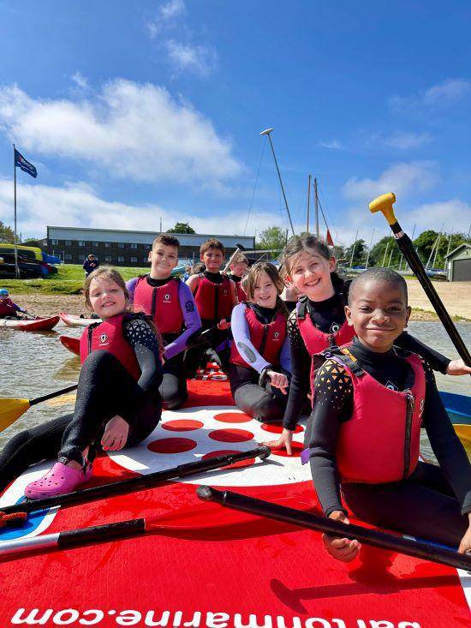
Grafham
Water
Residential trip
20th – 22nd
October 2025

Slide 2
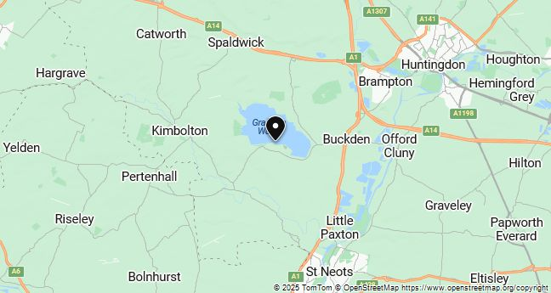
Where are we going?
Just a few short miles from Huntingdon in Cambridgeshire, Grafham Water, England's third largest reservoir can be found nestled in 1500 acres of beautiful countryside.
Grafham Water has been designated as a Site of Special Scientific Interest for over 30 years. Our western end features a 280-acre nature reserve and is home to ancient woodlands, reed beds and important populations of several bird and amphibian species.

Slide 3
Who are the adults coming?
Mrs Gray,
Miss Bird,
Mr Cowie,
Mrs Bryson
and Mr Troth

Slide 4
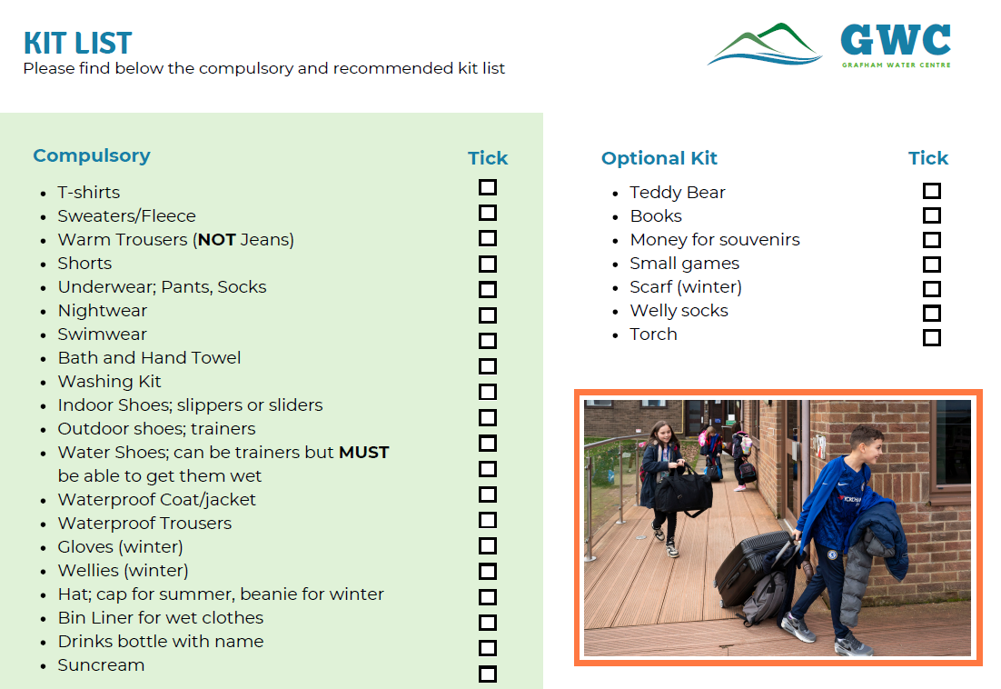
What do I need to pack?

Slide 5
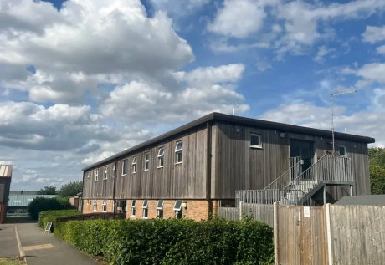
Where will
I sleep?
INDOOR ACCOMMODATION
Bunk bed accommodation sleeping 2-6 people per room
Communal lounge facility
All bedding and pillows are provided (children will have to make their own beds on arrival)

Slide 6
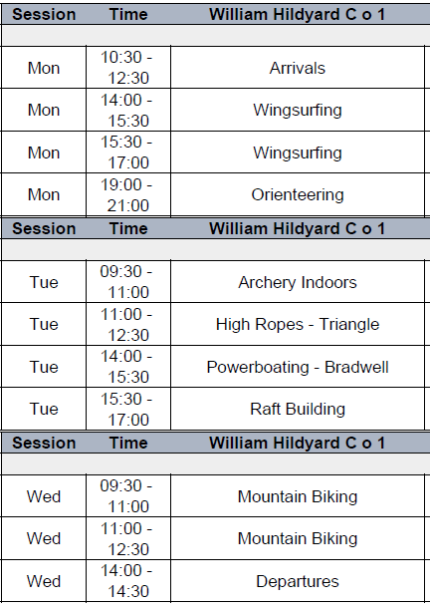
Itinerary
Children will be organised into 4 groups of 10.
Each group will contain boys and girls from Year 5 and Year 6
Example of one group’s timetable

Slide 7
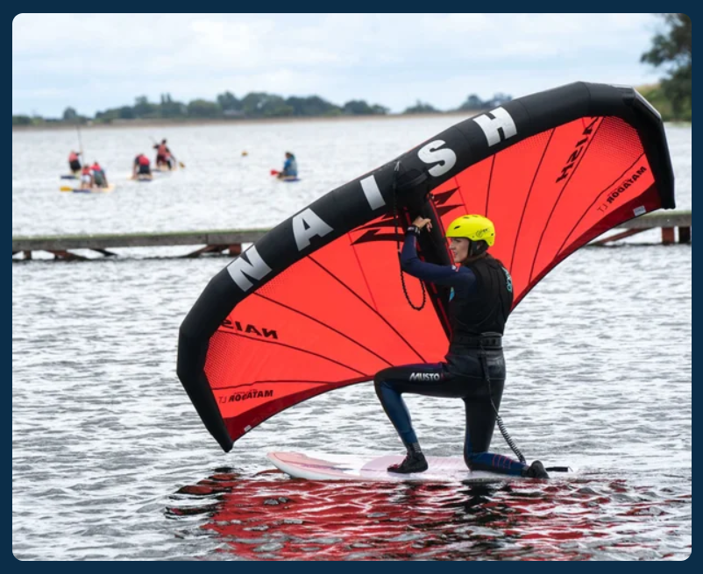
Wing surfing
Wing surfing is a wind propelled water sport that developed from kitesurfing and windsurfing.
This activity combines paddleboarding with an inflatable wing acting a sail. The sailor, standing on a board, holds directly onto a wing. It generates both upward force and sideways propulsion and thus moves the board across the water. It is a young sport and has recently been added to our activity offer at Grafham Water Centre in 2023.
There are small wings for pupils and this activity is easier than wind surfing.

Slide 8
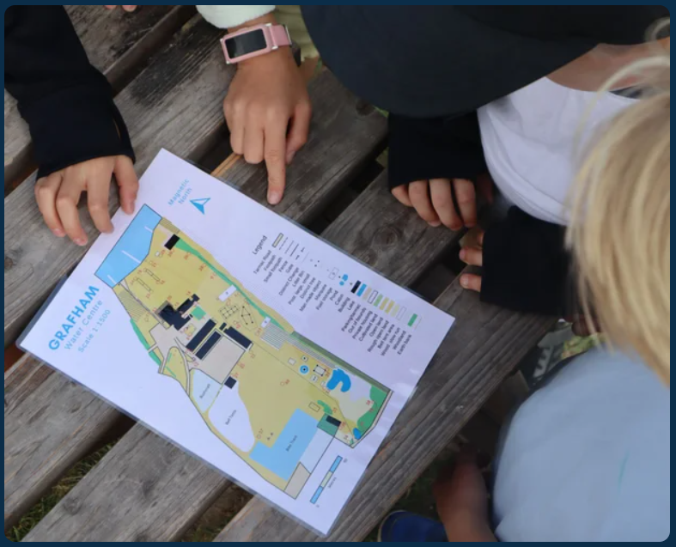
Orienteering
The on-site orienteering course tests groups navigation, planning and teamwork skills.
Participants are given a map and briefed on simple map reading skills before being set off on navigational challenges around the site. Working in small groups, pupils will use the map to find posts around our site that have the answer to a question that they will record.
This will be used as an evening activity.

Slide 9
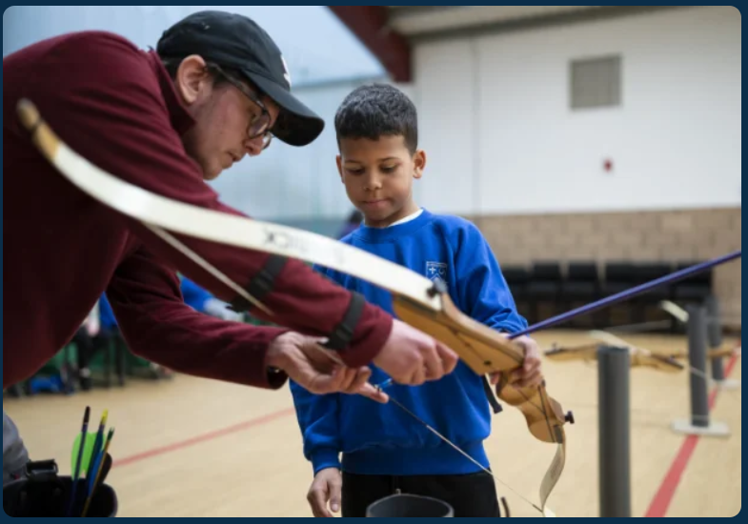
Archery
Learn how to shoot like Robin Hood, play games and develop core skills such as control, perseverance and coordination.
This activity can be adapted for all less abled participants with our specialist equipment if necessary, so everyone can participate.
During this session they will learn the essential skills of archery.

Slide 10
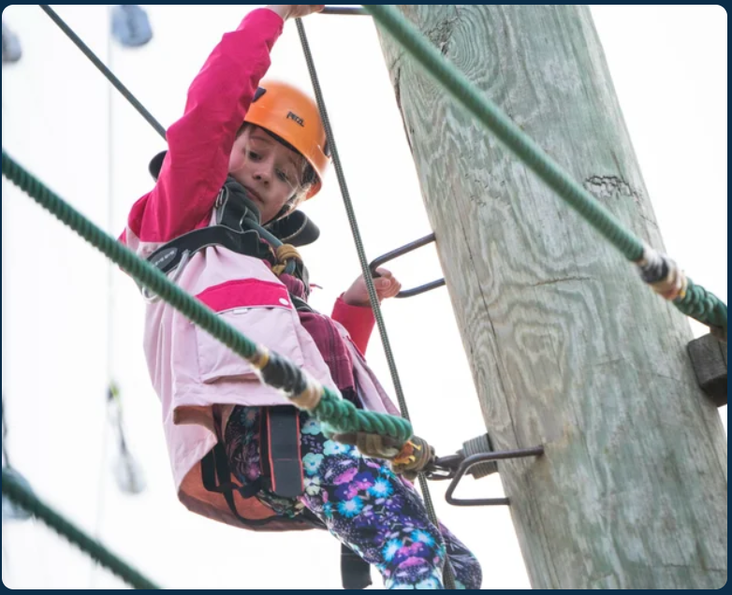
High Ropes - Triangle
INDIVIDUALLY GAIN CONFIDENCE AT HEIGHT
A solo high ropes activity - this is your 'go ape' style activity.
Teammates hold the ropes to keep climbers safe.
There are 3 sides to the Triangle course and two are used in each session

Slide 11
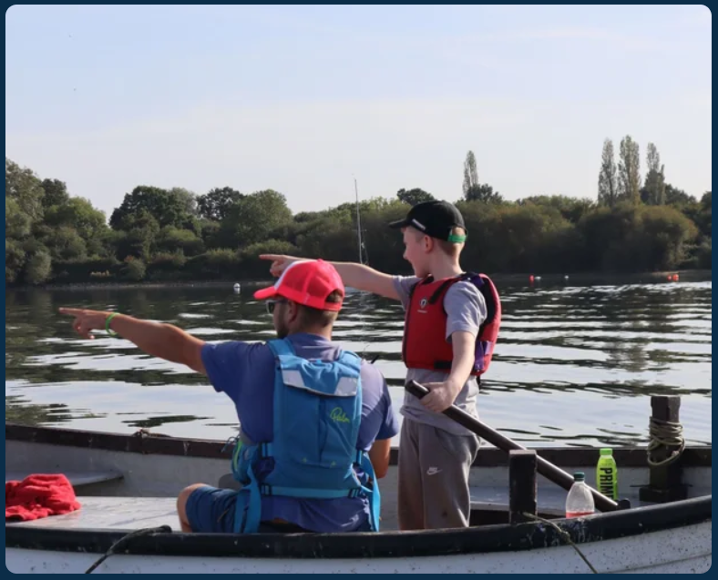
Powerboating
ENJOY A PEACEFUL EXPLORE
Bradwell and Tinkerbell are the Powerboats. This a dry activity where the whole group will be in the boat at once.
Each student will have the opportunity to drive the powerboat as well as learn some key facts about the reservoir and play games.
We are proud to have the Bradwell as the battery powered electric engine is kind to our environment.

Slide 12
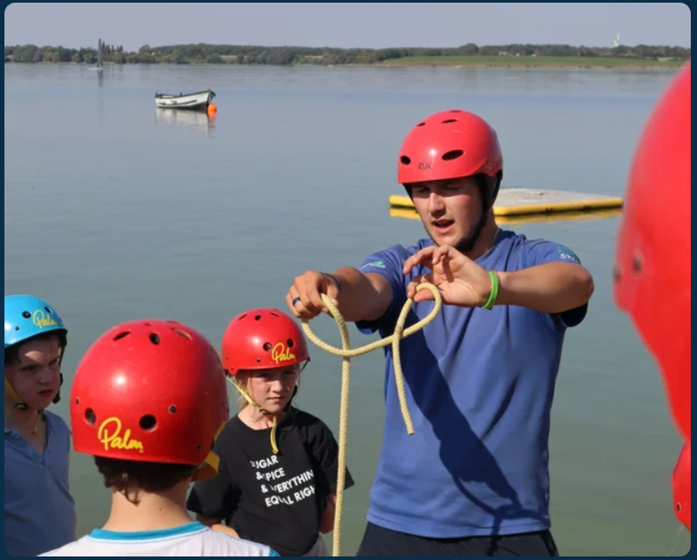
Raft building
UNLEASH YOUR IMAGINATION TO CREATE YOUR DESIGN
If you want to really test your teamwork and planning skills, then raft building is the activity for you.
Each group is issued with ropes, poles and barrels in order to build a floating craft which will stay afloat with every group member on board.
This activity can involve lots of wet people, some interesting designs and lots of fun!

Slide 13
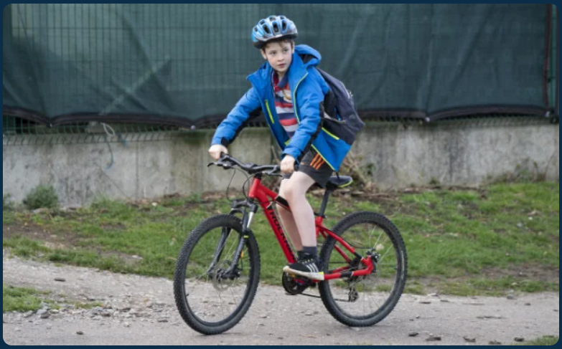
Mountain biking
DEVELOP YOUR RIDING ABILITY HERE
Grafham is in a perfect location for mountain biking with a 9-mile cycle track that navigates around the reservoir. You can complete the full route, or cycle 2 or 3 miles round and then do the same route back.
There is also an option to go on our mountain bike skills track. Our off-road bikes will aid you up even the steepest of slopes around the reservoir.
There are tandems and tag along bikes for less able riders.
If you child cannot ride a bike, please tell me. We can phone ahead to secure the tandems, tricycles or tag along bikes.

Slide 14

We are planning to spend the second evening enjoying a film night. We will choose an age-appropriate film and provide snacks and drinks.

Slide 15
Medication
All medication must be handed in on the morning of departure to the adults. The medication must be in a labelled container or bag, with the child’s name and their dosage instructions clearly shown.
Care plans for allergies and asthma will be taken, so please update them if necessary.
The adult supervising your child’s day group will administer any medications and will always carry all necessary medications with them. Adults will have mobile phones to enable them to contact other leaders, school or emergency services.

Slide 16
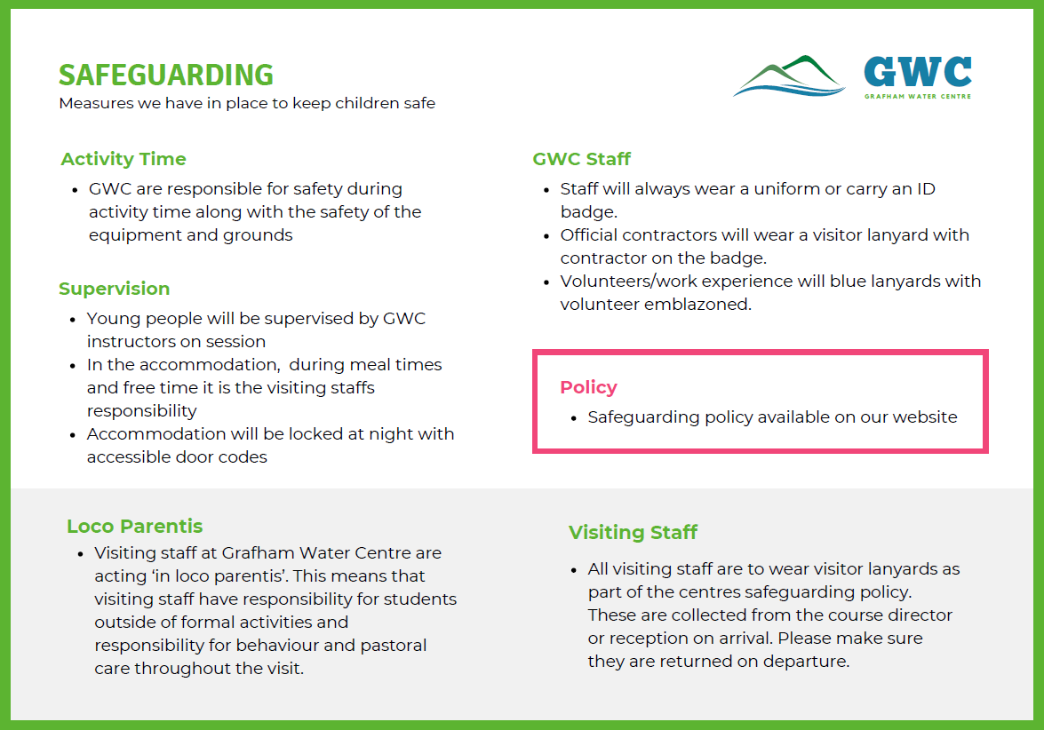

Slide 17
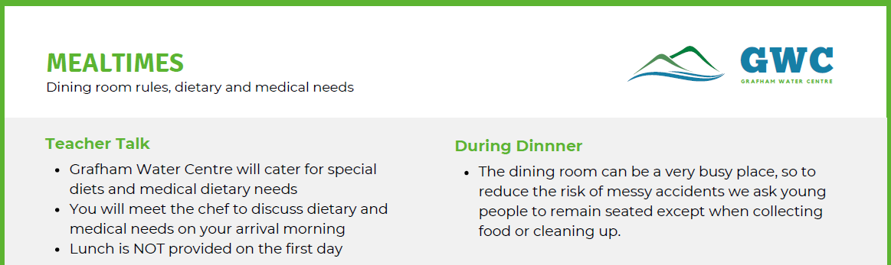
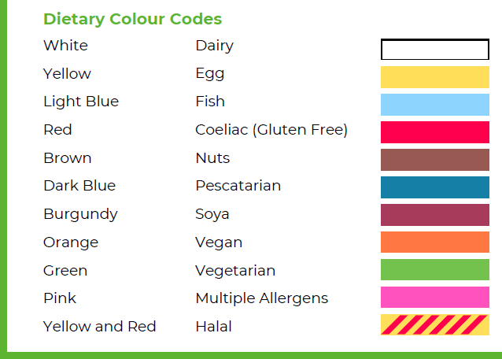
It is the teacher responsibility to
ensure the young people with
dietary and medical needs
collect the correct food from the
servery. These young people will
always be at the front of the
queue and will wear wristbands

Slide 18
What NOT to bring:
No snacks – there will be plenty of food provided
No phones or smart watches – this is a policy for us and the site and is a safeguarding issue.

Slide 19

And finally…
We are planning to have a wonderful time at Grafham Water. Please remind your child that good listening and good behaviour will help us in this.
Thank you.

Slide 20
Any questions?

