Slide 1
St. GEORGE’S CHURCH OF ENGLAND Primary AND NURSERY School
Relationships AND Sex Education
Consultation with our School Community

Slide 2
New Guidance
It has been 20 years since the last review of the curriculum - the world (and how we interact with each other) has changed
New - Relationships Education in Primary Schools
Previous recommendations for teaching Personal, Social, Health Education (PSHE) are now part of the National Curriculum.
Sex Education in Primary Schools remains optional, though in Year 5 & 6 the science curriculum forms part of what might be considered as sex education - puberty and reproduction. This is statutory and children must be taught this content.

Slide 3
Science Curriculum
As part of the Science curriculum we teach the following statutory objectives that build understanding about growth and reproduction:
Year One
Identify, name, draw and label the basic parts of the human body and say which part of the body is associated with each sense.
Year Two
Notice that animals, including humans, have offspring which grow into adults they should not be expected to understand how reproduction occurs.
Year Five and Year Six
Describe the life process of reproduction in some plants and animals. They should learn about the changes experienced in puberty.

Slide 4
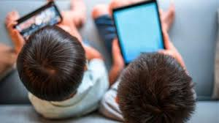


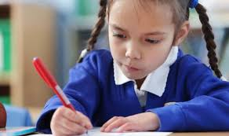
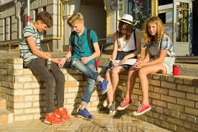
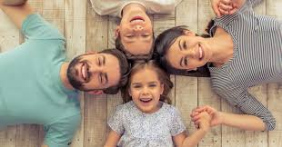
Where and how did you learn about sex and relationships?
For young people now, their learning comes from…
TV
Internet
Mobile phones
School
Friends & Older Siblings
Parents & Carers

Slide 5
Why is Relationships and
Sex Education important?
    Entitlement
    Puberty is starting earlier - for some children by age 9
    Unwanted conceptions
    Sexually transmitted infections
    Safeguarding
      Grooming
      Child Sexual Exploitation
      Abuse
      Sexting
      Online pornography

Slide 6
What is effective
Relationships &Sex Education (SRE)?
    Age appropriate
    Based on needs of pupils
    Progressive
    Inclusive
    Delivered by trained staff in a safe environment
    Prepares children adequately for puberty in a timely way
    Prepares children for adult life
    Promotes positive relationships

Slide 7
Does it work? What’s the evidence?
  Those receiving good quality RSE are more likely to:
    Delay their first sexual experience
    Use condoms for contraception
    Have fewer sexual partners
    Kirby 2007

Slide 8
Ofsted review of existing RSE nationally
  Required improvement in over a third of schools, it was not systematic enough.
  Children were not adequately prepared for puberty.
  In Primary Schools, too much emphasis was placed on friendships and relationships.

Slide 9
Your rights as a parent:
  To be informed of the RSE curriculum and policy.
  To be consulted about changes to these.
  To withdraw your child from Sex education lessons (that are additional to the Science National Curriculum)

Slide 10
What do children say?
What children think about relationships:
Typically a Year 2 might say:
Friendships – where you really like someone you chat and play together.
Some mums and dads do/don’t have relationships. Curious to know why.
It’s when you love each other.
Typically a Year 4 might say:
It is when you are happy with someone you really like or even love.
It is being able to talk to someone you trust.
Its when you are kind to each other and look after each other.
Typically a Year 6 might say:
You can get healthy and unhealthy relationships.
Its not good if people argue, you have to have respect in a relationship.
Sometimes people get married but some don’t and that’s ok.
It could be a boyfriend or a girlfriend if you are older.

Slide 11
What do children say?
What children feel they need to know about now:
Typically a Year 2 might say:
Mainly about rules and keeping safe (zooming safely, ‘stranger danger’).
How to not fall out so much.
Why do parents sometimes split up?
Typically a Year 4 might say:
What healthy relationships look like.
Body changes - growing bigger, voice changes
Marriage and dating (though they didn’t think any dating would start until secondary school)
Typically a Year 6 might say:
Hormones, body changes, relationships with family/friends, gender and sexuality; gender stereotypes.
Fake accounts online and adults pretending to be children.

Slide 12
What do children say they need to know?
    Year 2:
    Internet safety and strangers ‘pretending’ to know you.
    How to use a phone.
    Who they will marry.
    Year 4:
    Having babies – knowing when you should have them.
    A good age to have a ‘proper’ relationship.
    Body changes - periods and hair growing under armpits.
    Year 6:
    When it is a ‘good age’ to have a baby.
    What happens when you have a baby.
    To know how and when to ‘do it’ and how to be safe.
    How to know if you are safe in a relationship.

Slide 13
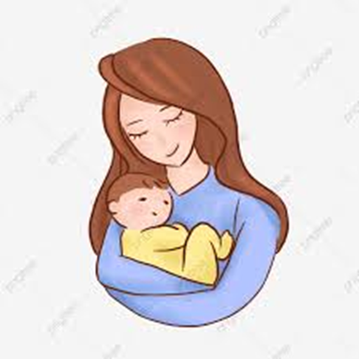
In the picture where did children think the
baby had come from?
Year 2: It could be found on a doorstep from God It is from her tummy Sometimes mums adopt a baby and they find the baby in a box by the front door. They just find them It’s from her noo noo No the privates It came out of the bottom It came from her mouth Did it come out of the belly button? | Year 4: I heard it really hurts A girl and a boy did it It might have been adopted It’s was peanut in the belly Heaven – they come from God he makes them After a girl falls in love some tadpoles go to her core thing and lay eggs in the belly It was from her vagina or was it the bottom? Giggles and confusion It’s the bit in front of the bottom | Year 6: Lots of giggling It comes from the mother, from inside her A man and a woman have fun At the hospital the lady makes loads of noise and has it out They get it out in a big bath You push it out The man gives the lady a seed and the seed fertilizes an egg Squirmy things travel through the body and try to get into the egg and if three get in they could have triplets From a hole that stretches and you sometimes need stitches

Slide 14
Summary
Parents have the right to withdraw children from Sex Education lessons at Primary School that go beyond the content in the Science National Curriculum.
Topics covered related and linked to the Science Curriculum are statutory and not optional to teach. This is as follows:
    In Key Stage 1, children learn that animals, including humans, have offspring that grow into adults. They should be introduced to the concepts of reproduction and growth but not how reproduction occurs.
    In Upper Key Stage 2 (Year 5/6), children are taught about the life cycles of humans and animals, including reproduction. They also learn about the change that happen in humans from birth to old age. This includes learning about what happens in puberty.
School’s have the right and obligation to teach RSE to prepare children for life when they leave school.
The curriculum on Relationships and Sex Education should complement, and be supported by, the school’s wider policies on behaviour, bullying and safeguarding (PSHE; E-Safety, Relationships etc.)

Slide 15
Next Steps:
Please look at the materials on the school website :
Please respond to the survey:
We are particularly interested in your views about when to tackle different concepts and any areas you might like further support with at home.
We are aware that there will be differences of opinion, but we will take your views into account when we finalise our policy and curriculum plan.
We will share this with you when it is finalised. Thank you.

